Slide 1
WCASD
Financial Aid Night
Dr. Tori Nuccio
Deputy Director
WEST CHESTER UNIVERSITY

Slide 2
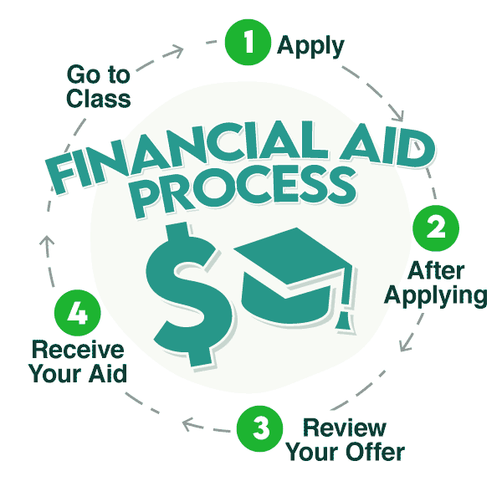
AGENDA
What is financial aid?
Types of aid
How do I apply for financial aid: FAFSA Changes
Student aid index (SAI)
Financial need
Special and unusual circumstances

Slide 3
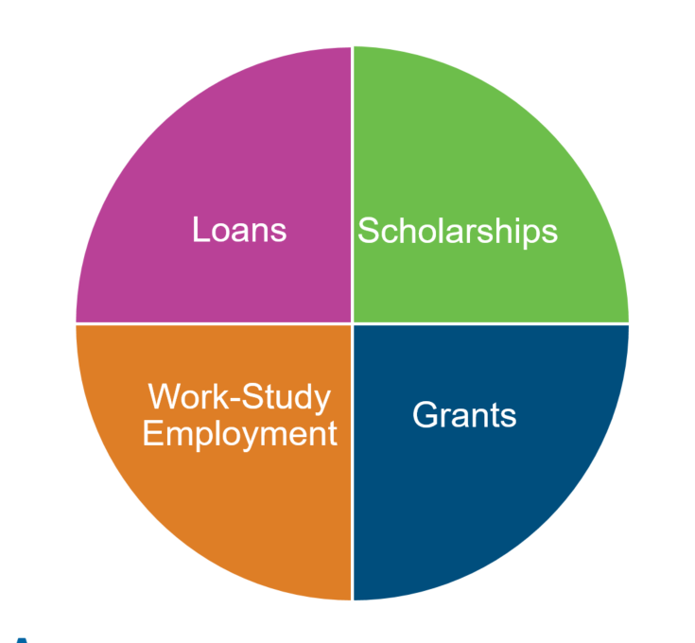
WHAT IS FINANCIAL AID?
Financial aid consists of funds provided to students and families to help pay for postsecondary educational expenses: WCU Application is the FAFSA.

Slide 4


SCHOLARSHIPS: MERIT-BASED GIFT AID
Outside Scholarships: Apply early and often
  Local: High School, Parents Employers, Community Organizations
  Websites: Scholly, Raise.me, Fastweb, and Chegg
Institutional: From the College itself
  Does it require a separate application?
  Can it be appealed?
  What do you need to do to keep it?

Slide 5
GRANTS: NEED-BASED GIFT AID
Federal
  Pell: Maximum $7395
  SEOG: Based on School
  TEACH: Max $4000; not all schools participate
State
  PHEAA: amount depends on type of school
  Special programs
Institutional : School decides

Slide 6
FEDERAL LOANS
First Year Independent
  $9500 Total Offered
    $3500 Subsidized
    $6000 Unsubsidized
First Year Dependent:
  $5500 Total Offered
    $3500 Subsidized
    $2000 Unsubsidized*
    Students may get additional *$4k if parent denied on PLUS loan
Subsidized
  No interest while enrolled
Unsubsidized
  Interest accrues while enrolled.
Repayment starts 6 months after graduation!

Slide 7
STUDENT EMPLOYMENT
Not all campus jobs are through federal work study. If you do not qualify for federal work study ask about other opportunities to work on campus.
FEDERAL WORK STUDY: NEED BASED AND SCHOOL BASED
  Doesn’t pay towards tuition but instead earned through a paycheck
  Typically students can start applying for jobs after committing to their college
  If funds are not utilized for work study then returned to a fund for another student to earn

Slide 8
Free Application for Federal Student Aid: What is staying the same?
FREE!!
Filed every year
Seniors: 24-25 FAFSA open by Dec 31 with schools getting information in late January
All other grades: starting back-up with 25-26 FAFSA opens on October 1st.
Uses prior-prior tax information. 2022 taxes for 24-25 FAFSA
Can list up to 20 Schools (vs. 10) on the FAFSA even before being accepted.

Slide 9
What is changing with the FAFSA form?
FAFSA SIMPLIFICATION:
  FUTURE ACT:
    IRS Information is no longer an optional tool but a requirement
    National trend of more Pell recipients, larger Pell awards, and lower SAIs vs. EFCs
    Changes who is listed on FAFSA: Student/Parent/Spouses are now referred to as “contributors” and it is possible to need more than one parent to sign the FAFSA if “married filing separately”.
    Changing treatment of multiple family members in college
    Changing treatment of small businesses and farms.
    Expected Family Contribution (EFC) is now the Student Aid Index (SAI) and starts at -1500

Slide 10
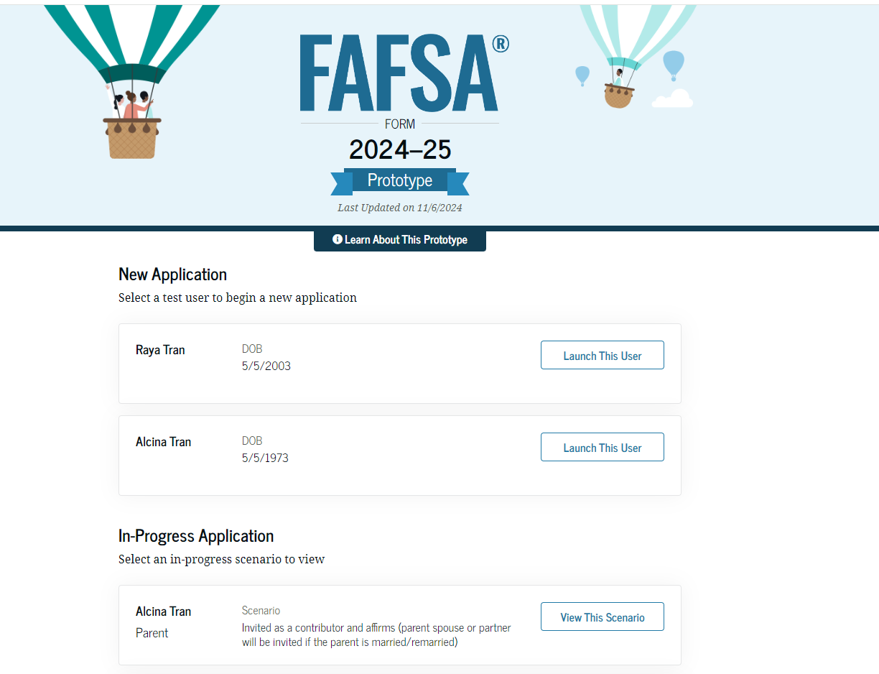
How will the FAFSA look?
New Workflow for filing?
Student goes first
Identifies and invites contributors
Contributors enter through invite via email
Consent required for eligibility
Complete as separate sections.

Slide 11
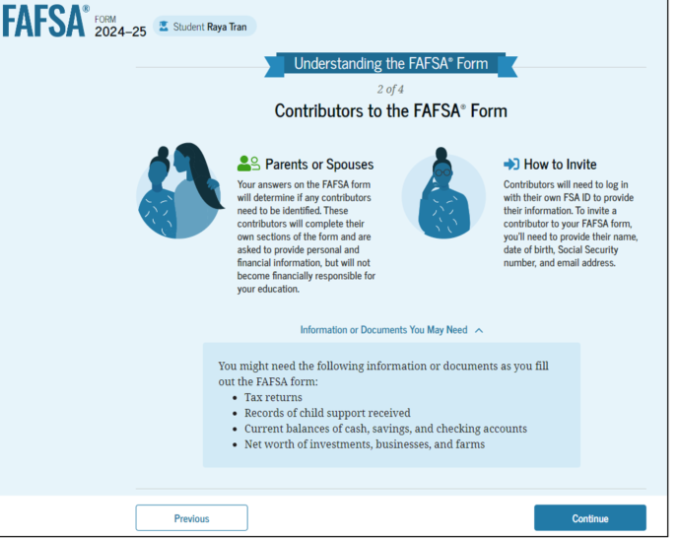
Who are my contributors?
Check out the parent wizard!!
Student and spouse if married.
Student and biological/adoptive parent who provides most financial support.
If biological parents are re-married than the step-parent (income included on FAFSA but no in decision making process).
If two parents qualify as contributors and file separately then both will need to give consent and sign FAFSA.

Slide 12
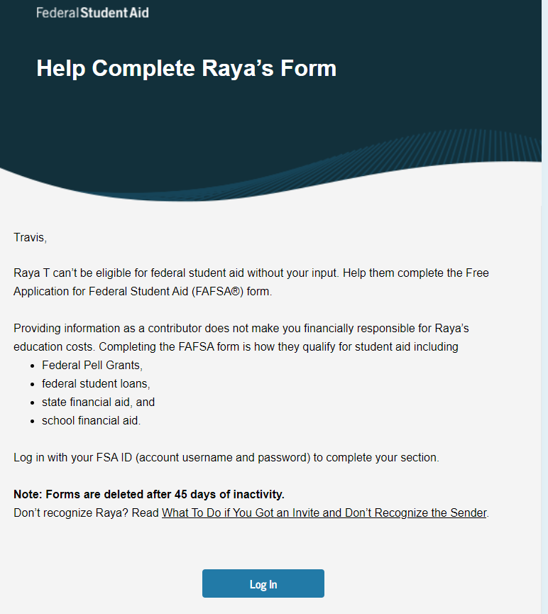

Slide 13
How is the Student Aid Index Used?
Student Aid Index (SAI): Number resulting from the evaluation of a student’s (and family’s) approximate financial resources for a student’s postsecondary education
Cost of attendance (COA) – Student aid index (SAI) = Financial need

Slide 14
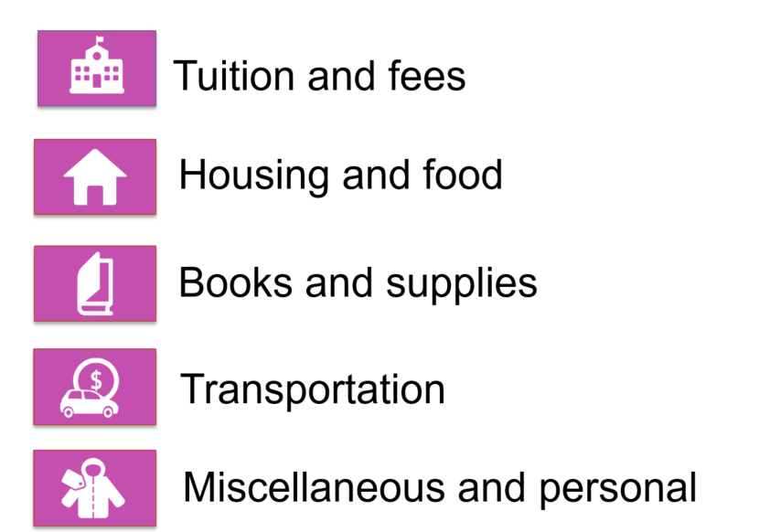
What is the Cost of Attendance
Housing Plans are no longer collected on the FAFSA: make sure to update college if your housing plan is changing.

Slide 15
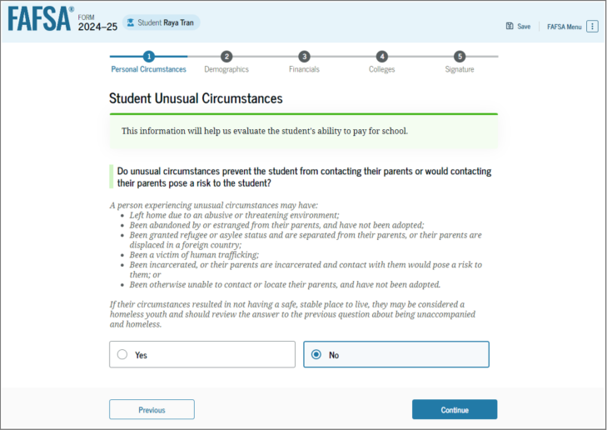
What if I cannot get parent information? Unusual Circumstances
FAFSA will now calculate a provisional SAI if parent data is missing and students need to appeal.
If students do not qualify to be independent but parents refuse can request to be considered for an unsubsidized loan only.

Slide 16
What if my income or household changes?
Financial Aid office (not the student) can update the FAFSA for changes in circumstances.
After filing the FAFSA student can request a Special Circumstances Appeal.
Incoming students may also have the opportunity to complete a separate appeal after receiving their financial aid offer for additional institutional aid.

Slide 17
What if I still need assistance with costs?
Payment Plans
Federal PLUS Loan
Private Education Loan
Offered by the school
Typically have a fee associated with enrollment but no interest.
Can have deadlines to enroll so ask early even before official bills are released
https://studentaid.gov
For parents of dependent students. Parents login before applying.
Interest fixed once assigned but updates from year to year (Currently 8.05%)
If denied student can get additional unsubsidized loan funding.
Unique as funding goes directly to the school and is certified by the school.
Lenders are competing so want to compare not just rates but offerings for interest discounts and repayment terms.
Recommend applying annually to avoid multiple credit checks.
Wcupa.edu/privateloans

Slide 18
Major take-aways:
FAFSA Filing
What can I do now
After FAFSA?
FAFSA is delayed and will look different.
Considering signing up for a FAFSA filing workshop for the school you are attending/accepted to for assistance.
Each contributor will need a studentaid.gov account/FSA ID so start setting those up now.
Read university financial aid webpages to see if process has changed and if they are asking for an institutional application.
Apply for outside scholarships.
Ask about appeal procedures and payment plans.
Visit PHEAA.org to complete state grant process
Monitor student’s email and text messages for financial aid offers and start storing in a shared space for comparison.
Setup appointment with financial aid office to review aid and any necessary tasks to secure aid.

Slide 19

Q&A

